Slide 1
Azure Functions – Getting started
Mark Gossa
Infrastructure Engineering Lead, UK Banking

Slide 2
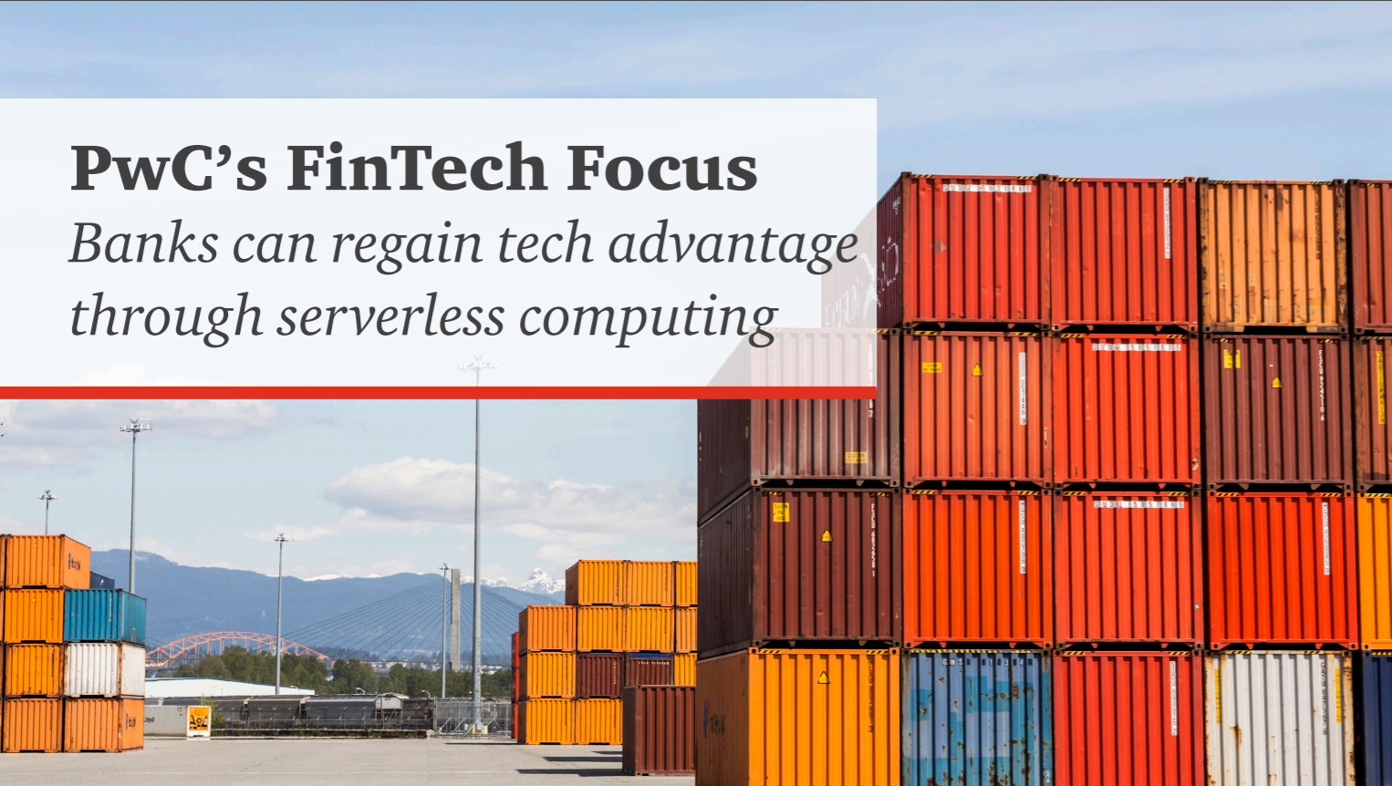
https://www.pwc.com/us/en/industries/financial-services/library/serverless-computing.html

Slide 3

About me
Mark Gossa
Infrastructure Engineering Lead
@markgossa
https://markgossa.blogspot.com
Github.com/markgossa
Notes:
All things DevOps
Infrastructure as code
Mostly serverless

Slide 4
oVERVIEW
Benefits of Serverless
Azure Functions
Azure Durable Functions
How to get started

Slide 5
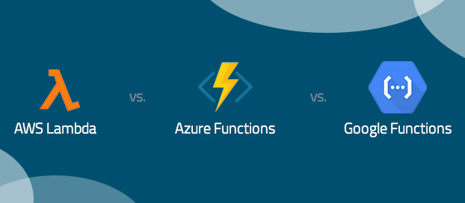
0 to API in 4mins

Slide 6

Serverless Benefits
Deploy server
Join to domain
Backups
Patch management
Access management
Load balancing
OS security hardening/scanning
Networking
Deploy application code

Slide 7
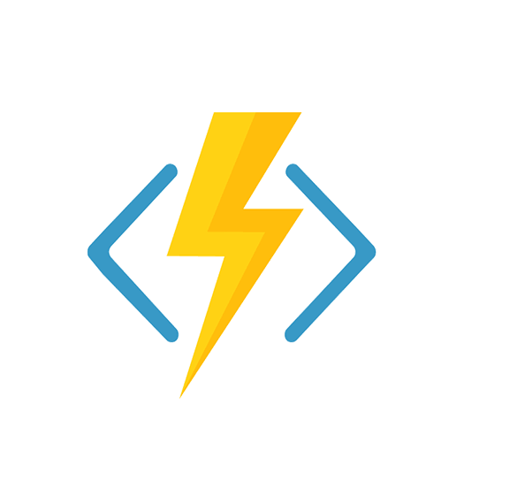
Serverless Benefits
Deploy server
Join to domain
Backups
Patch management
Access management
Load balancing
OS security hardening/scanning
Networking
Deploy application code

Slide 8
Azure Functions - Overview
Run small pieces of code in the cloud
Local development environment
Multiple languages
Multiple triggers

Slide 9
Azure Functions - Plans
 | App Service Plan | Consumption Plan | Premium Plan (Preview) | App Service Environment
Billing model | Pay for running instances | Pay per execution (GB/s) | Fixed cost for warm instances then pay for burst instances | Pay for running instances and base cost
Free allowance | N/A | 1,000,000 executions or 400,000GB/s | N/A | N/A
Cold start | No | Yes | No | No

Slide 10
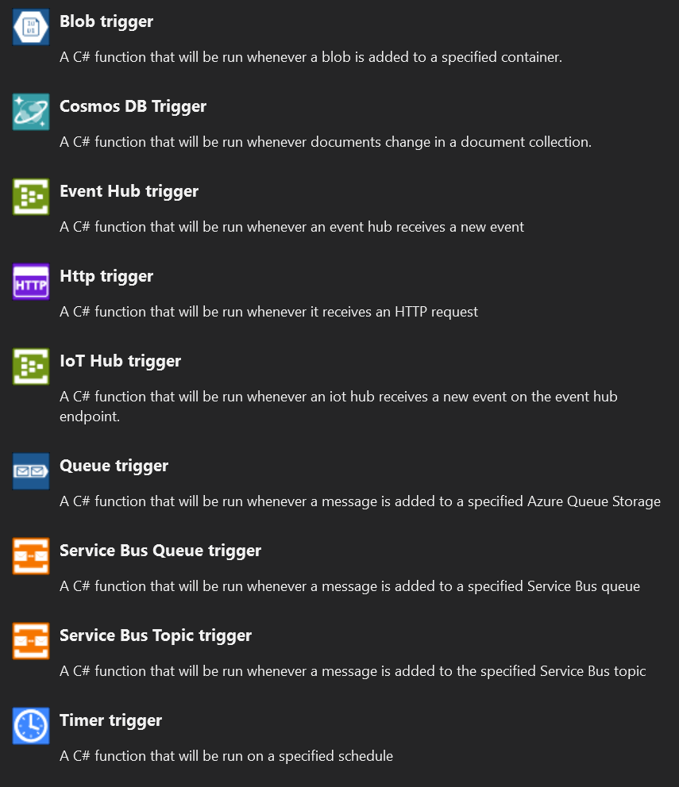
Azure Functions – Triggers and Bindings

Slide 11
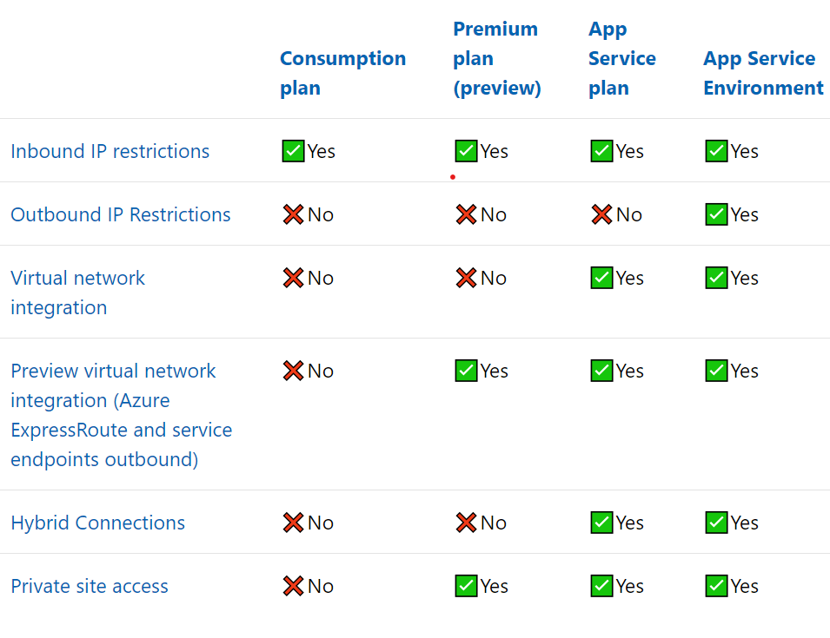
Azure Functions – Networking/Hybrid
Virtual network/Express Route integration (not consumption plan)
Service Bus/Storage Queue
Ultimate isolation: App Service Environment

Slide 12

Azure Functions - Security
Authentication
Traffic Encryption
Data Encryption
IP Restriction
Managed Identity
Small functions vs Monoliths
Function runtime scanning
Notes:
IP restrictions – consumption plan doesn’t have fixed IPs. ASPs have fixed IPs but can change in certain scenarios.
PureSec/Synk

Slide 13
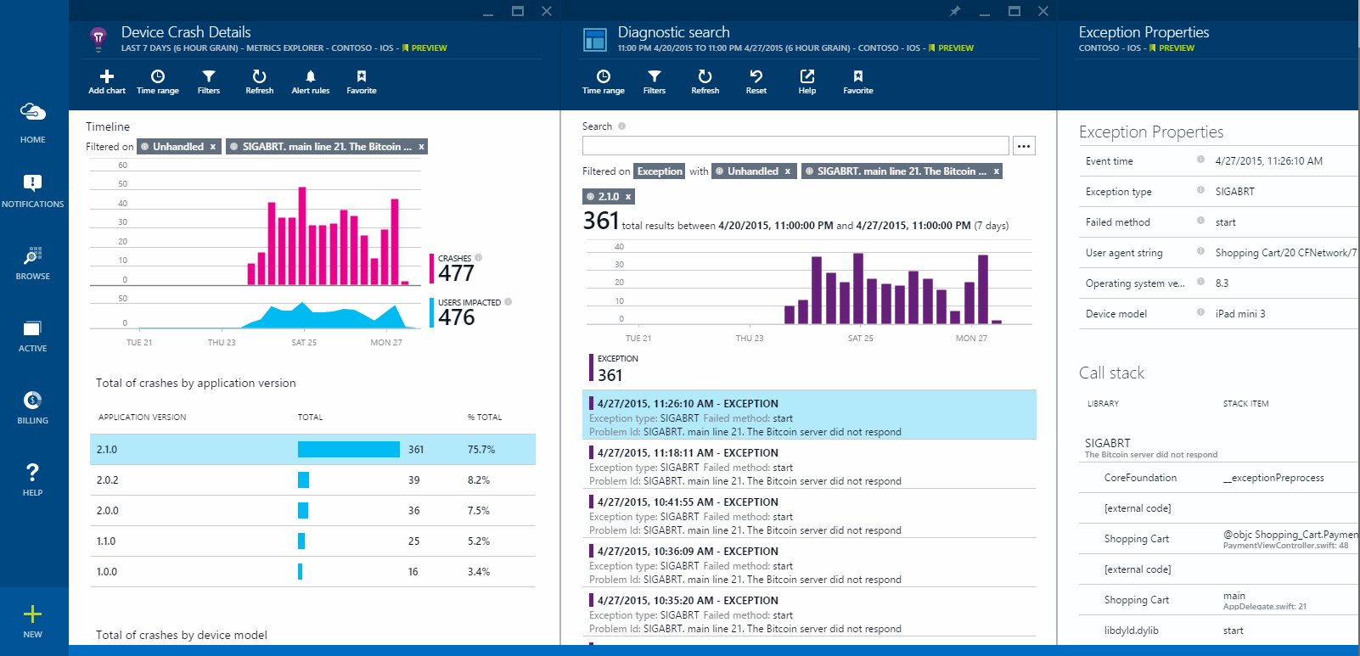
Azure Functions - Monitoring
Application Insights
Data Dog
Agentless

Slide 14

Azure Functions - Limitations
Different plans have different limits
Max execution time
Maximum outbound connections
Maximum concurrent requests
Max request size
Cold starts (consumption plan)

Slide 15
Demo: Azure Functions

Slide 16
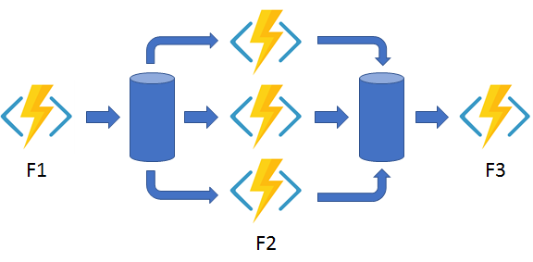
Azure Durable Functions
Orchestrating complex patterns
Stores state in table storage
Durable Task Framework
Built in queues
Notes:
All things DevOps
Infrastructure as code
Mostly serverless

Slide 17
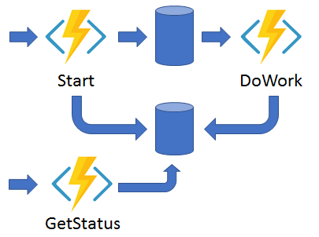
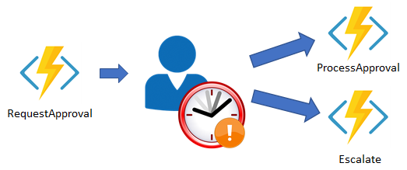
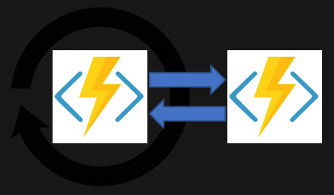
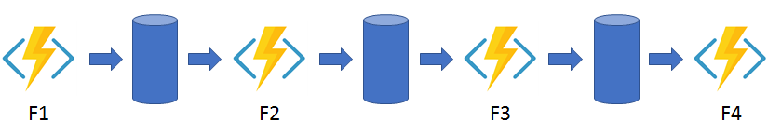
Azure Durable Functions - Patterns
Notes:
Fan in/out
Async
External event
Chain
Monitor

Slide 18
Demo: Azure Durable Functions

Slide 19







Who’s using Serverless?

Slide 20
Summary
Benefits of Serverless
Azure Functions: plans, triggers, security, monitoring
Azure Durable Functions: patterns, demo
How to get started

Slide 21
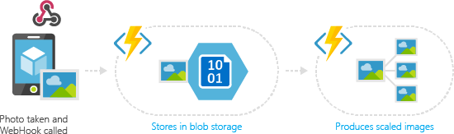
Where could we use Azure Functions?

Slide 22

Thanks!
Mark Gossa
@markgossa
https://markgossa.blogspot.com
Github.com/markgossa

